Slide 1
Bank Management System
project by, Guided by ,
Azhagu Raja.S Dr K Thulasimani
Chella Charan.S Professor
Siva.M Dept of CSE
GCE-Tirunelveli

Slide 2
Abstract
To Simplify the process so that the User can Create a new account, deposit and withdraw money and check their balance use the Software.
To Automate the Bank management system

Slide 3
Introduction
application for maintaining a personal account in a bank
access to the customer to create an account, deposit/withdraw the cash from his account
simple console based system which is very easy to understand and use

Slide 4
Drawbacks of traditional system
Opening a new account in a bank is a tedious process
Take up a lot of time and dampen the overall customer experience.
Moreover, many people have to make time to visit a bank

Slide 5
Scope
People can sign up and open a new account in a bank digitally.
Would save a lot of time and effort.
Allow the user to make transactions, deposit and withdraw funds, and check the account balance.
User interface is user friendly

Slide 6
System Requirements
Hardware Requirements
Processor – intel core i3
Memory – 4GB RAM
Hard Disk Drive – 100GB
Software Requirements
Front end / Back end – python
Platform – Windows 7

Slide 7
Project Prerequisites:
tkinter – utility to design GUI
command – pip install tkinter
Mysql- – interface for connecting to a MySQL database server from python
Pickle - Converting a Python object into a byte stream to store it in a file/database
command – pip install pickle-mixin

Slide 8
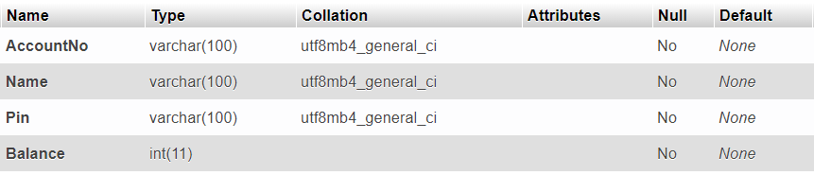
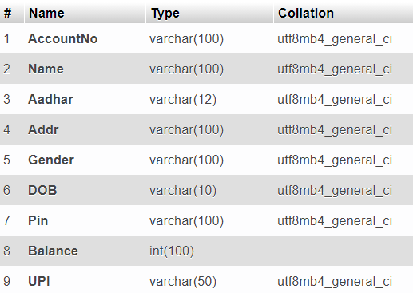
Table Design
Creating table in Database

Slide 9
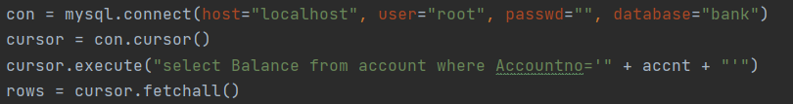
Implementation
MAIN PROGRAM
Importing the modules
Connecting to MySQL server
Designing the Window
Adding a Background image
Adding Buttons

Slide 10
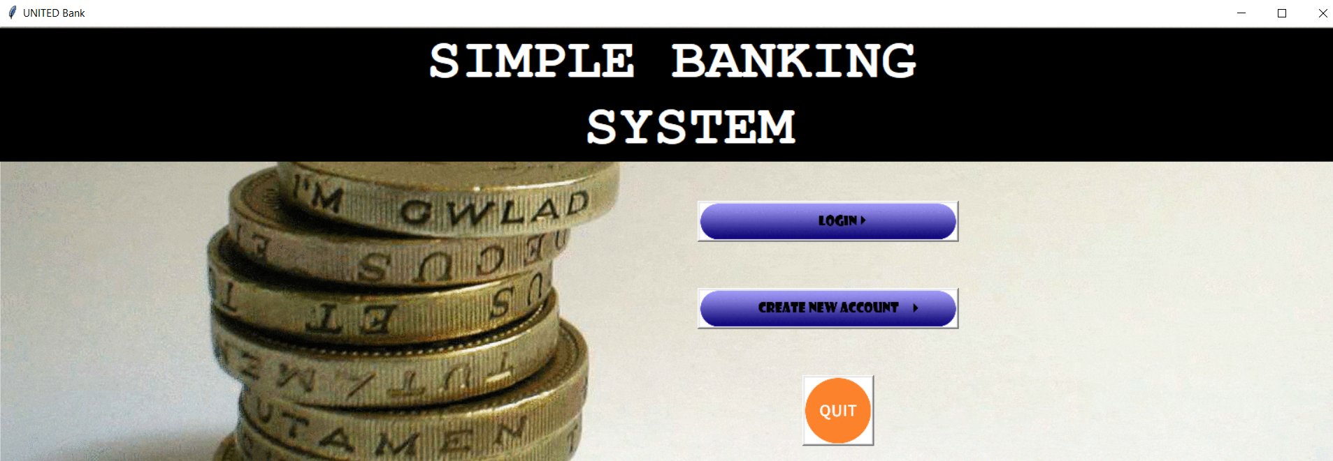
Screen Design

Slide 11
Modules
Create New Account
Log In
Send Amount
Check Balance
Transaction History

Slide 12
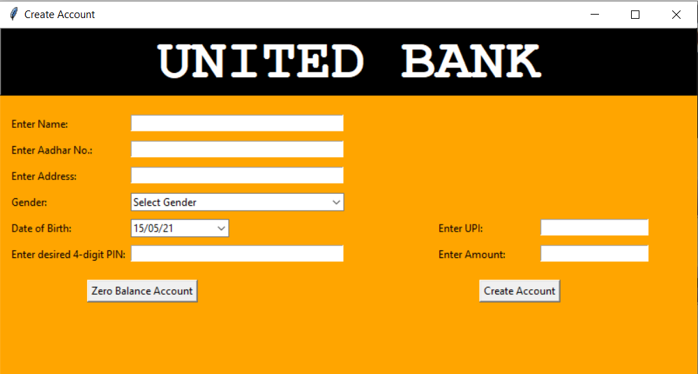
Modules (cont..)
Create New Account (Module 1)
write()- This function executes a SQL command to store the user data in Database

Slide 13
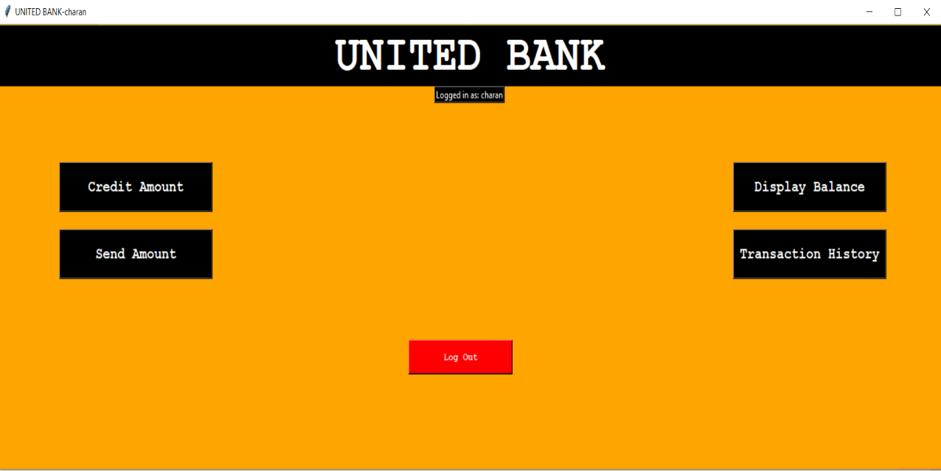
Modules (cont..)
Log in (Module 2)
check_log_in()- This Functions checks whether the details given by the user is valid. If the details are correct, login page will appear.

Slide 14
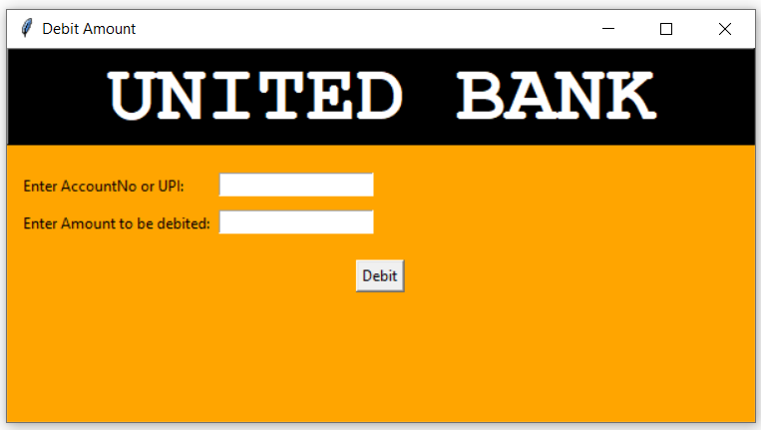
Modules (cont..)
Send Amount (Module 3)
debit_write()- This Function sends money through UPI.

Slide 15
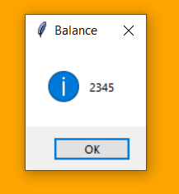
Modules (cont..)
disp_bal()-This Function shows the balance of the user which is stored in the Database.

Slide 16
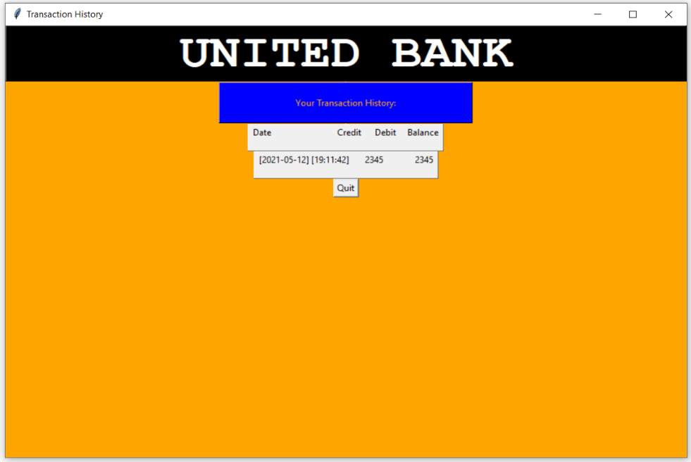
Modules (cont..)
Transaction history(module 5)
disp_trp_hist()-This function shows the transaction history of the user.

Slide 17
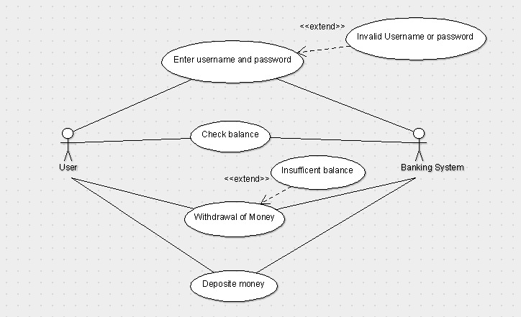
System Architecture:

Slide 18
Benefits
Provide flexibility
For better performance
Reducing man power
For doing work more accurately

Slide 19
Conclusion
This banking system will serve as useful approach to deposit and withdraw money for the person .
It reduces the time taken by the user to send money.
Bank system developed is user friendly.
It reduces manual work.

Slide 20
Thank You!

